Slide 1
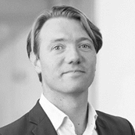
Bud van der Schier– Partner
Appendix [x
Experience
  Bud has worked for KPMG Deal Advisory, Global Strategy Group, since 2005 where he leads the Dutch Deal Strategy practice with an exclusive focus on deal/special events related strategy engagements. His experience with a specialisation in M&A related engagements includes commercial and operational due diligence, growth strategy development and operational restructuring work.
  Bud has specialised in Healthcare strategy and is closely involved with all major sponsors with a focus on Healthcare investments
Qualifications
  MSc Business Administration, Erasmus University Rotterdam, The Netherlands
Relevant projects
  [[
Contact
  +31 (0)6 511 86 859
  vanderschrier.bud@kpmg.nl
Bud van der Schier
PARTNER

